Slide 1
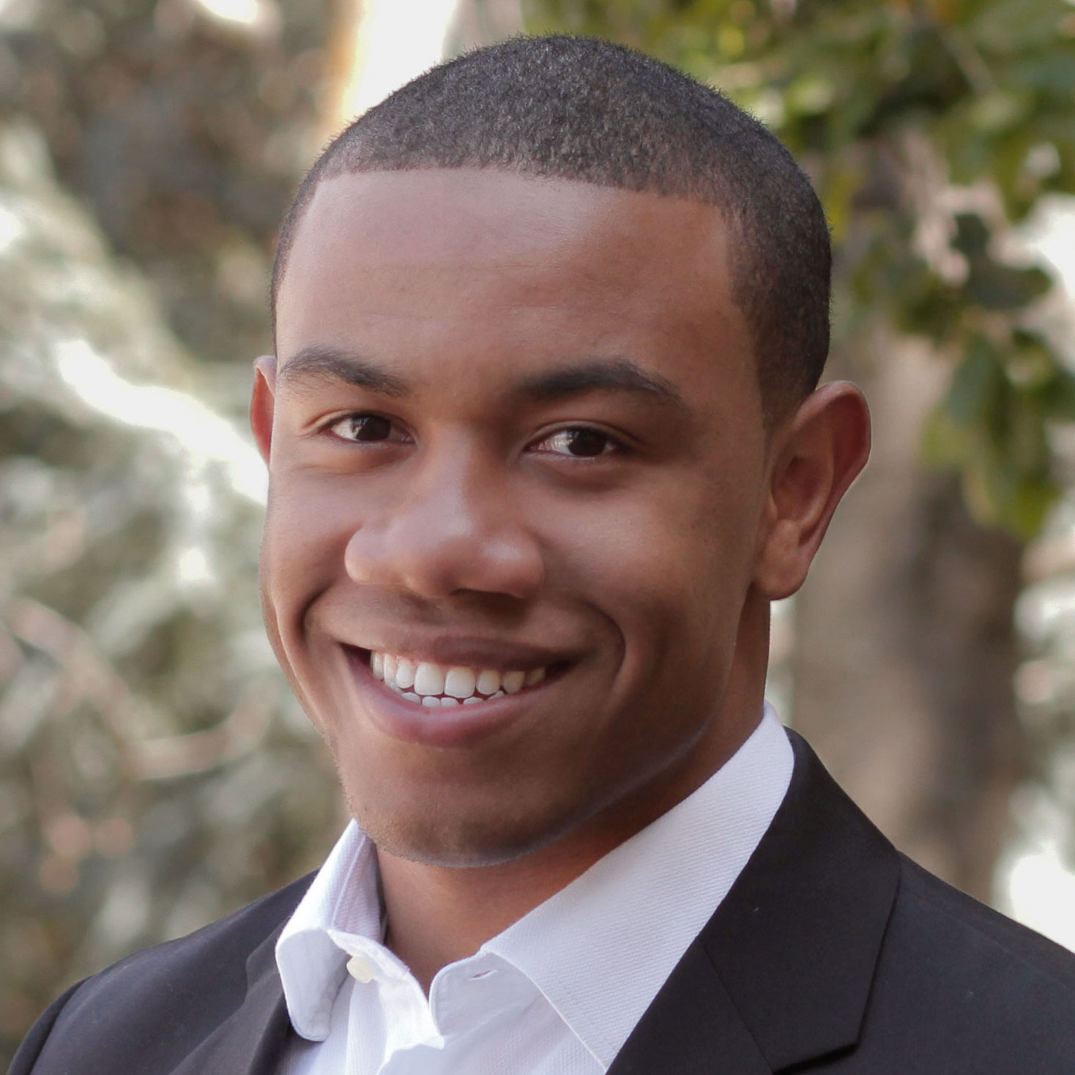

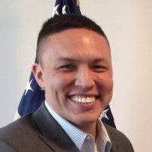
Needfinding
Team: Laura Brouckman, Matthew Chen, Leslie Kurt, Saamon Legoski
Studio: Digital Democracy
Presenter: Saamon Legoski

Slide 2
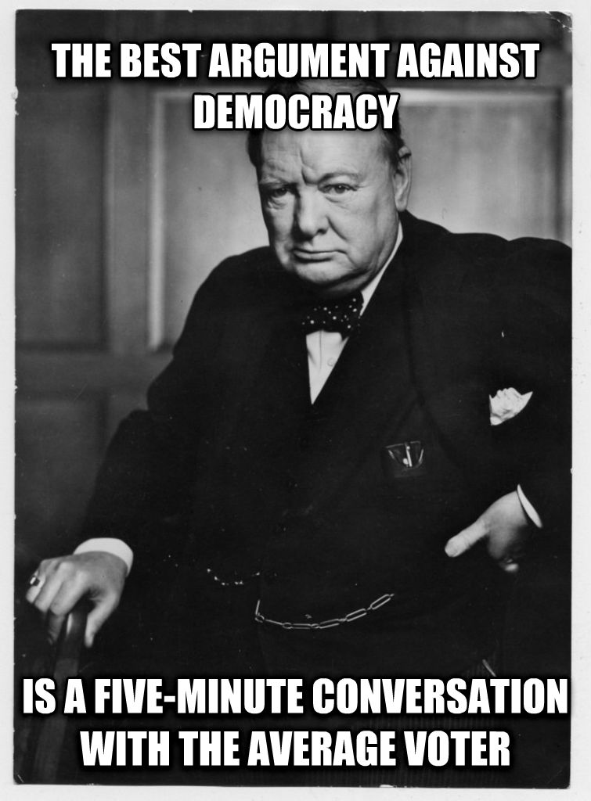
Problem Domain
(Un) Informed
Politics

Slide 3
Needfinding Methodology

Slide 4
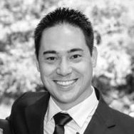
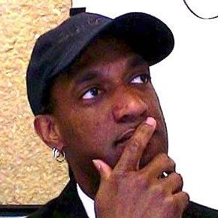
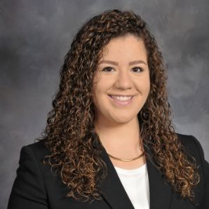
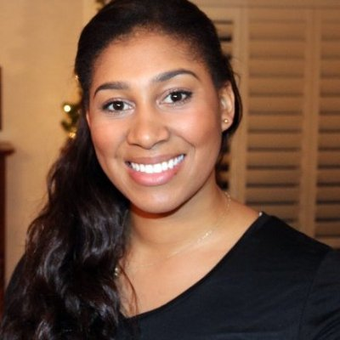



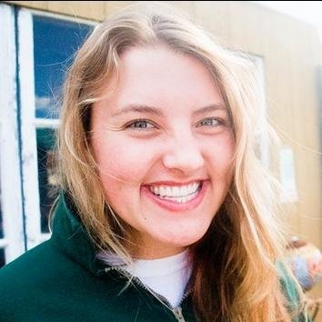

Who we interviewed
Notes:
Ages: college to teaching college for decades
Interests: From political experts to those who aren’t actually interested in politics (beyond what affects them)
Very wide ranging racial demographics, about equal split of genders
From conservative to liberal
Why chosen: from people on the street to the very informed
Where: NorCal to SoCal (via phone), recruited on and off campus in the general area
WHO: Students, professor, IT support, soldier, social justice warriors and researchers.

Slide 5
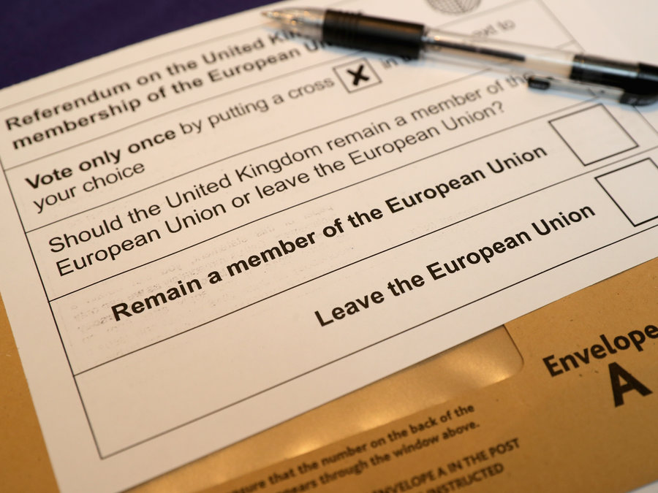
We asked about…
Voting experience
Media the viewer sees
Deciding how to vote on an issue
Notes:
Consistent questioning across individuals
Pros: aren’t scattered about with our questions and thus able to discern some kind of pattern
Cons: Maybe asking the same questions also reduces new insights (but that is why we asked follow-up questions)
How was the voting experience for you?
How do you decide how to vote on an issue?
How often do you see media that supports/contradicts your own opinion?
Have you ever voted on a referendum? How was that experience different?
What would you want to know about referendums beforehand?
Have you ever taken a quiz about politics that tells you which politicians/ideologies you align with most? Was it accurate/surprising/…?
How do you feel while reading something (political) that you disagree with?

Slide 6
Interview Results

Slide 7
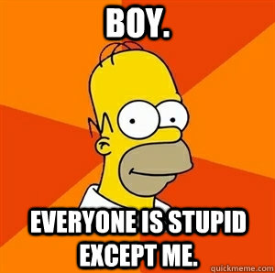
Interview Contradictions
How educated the voter feels:
“Only 2% of voters read as much as I read”
“I only read what comes in the mail”
“I think that I am more educated than the average voter”
“When I voted, I had a hard time feeling like an educated voter”
Notes:
Consistent questioning across individuals
Pros: aren’t scattered about with our questions and thus able to discern some kind of pattern
Cons: Maybe asking the same questions also reduces new insights (but that is why we asked follow-up questions)
How was the voting experience for you?
How do you decide how to vote on an issue?
How often do you see media that supports/contradicts your own opinion?
Have you ever voted on a referendum? How was that experience different?
What would you want to know about referendums beforehand?
Have you ever taken a quiz about politics that tells you which politicians/ideologies you align with most? Was it accurate/surprising/…?
How do you feel while reading something (political) that you disagree with?

Slide 8
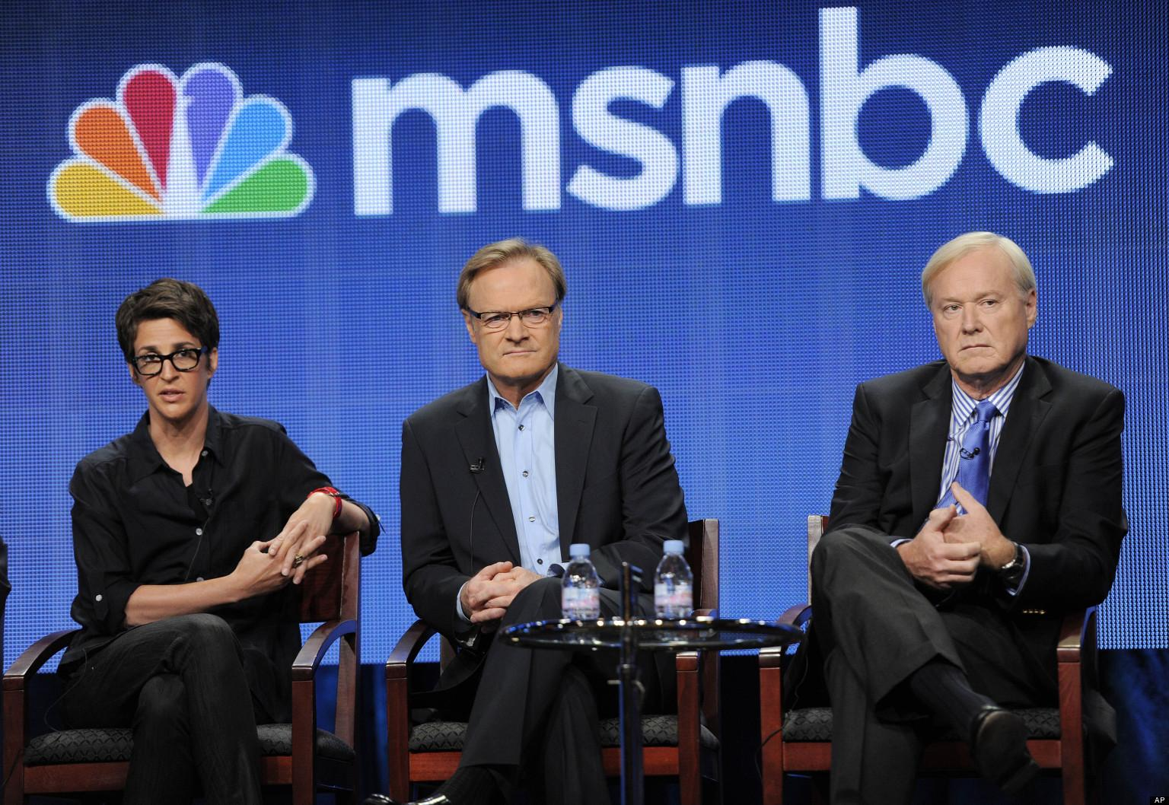

Interview Contradictions
“I look at articles published by [opposing view news source] so I can...”
“...argue more with conservative friends...I don’t use it for its ideas or news”
“...have an educated conversation with the other side”
“...fact check my own opinions”
“...sometimes refine my own ideas about an issue”
Notes:
Consistent questioning across individuals
Pros: aren’t scattered about with our questions and thus able to discern some kind of pattern
Cons: Maybe asking the same questions also reduces new insights (but that is why we asked follow-up questions)
How was the voting experience for you?
How do you decide how to vote on an issue?
How often do you see media that supports/contradicts your own opinion?
Have you ever voted on a referendum? How was that experience different?
What would you want to know about referendums beforehand?
Have you ever taken a quiz about politics that tells you which politicians/ideologies you align with most? Was it accurate/surprising/…?
How do you feel while reading something (political) that you disagree with?

Slide 9
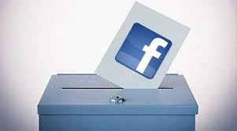
Interview Surprises
Misalignment between issues people supported and the candidates they voted for
People do not think about how they get their information
Interviewees were candid about their shortcomings
Notes:
People are really excited to vote for candidates BUT about issues people are unsure about like say Prop 66
Candidates: YEAH EXCITED issues: Ummmm what

Slide 10
Analysis / Empathy Map

Slide 11
Say
Do
Think
Feel
“People tend to stick to what they believe in”
“I do more research than the average person”
“It feels good to have something come up that you agree with”
People do not read documentation
Main source of the news is social media
Know more about politicians than propositions
Seeing one sided media
Their beliefs are more legitimate than others
They are more informed than others
They are getting a well-rounded version of news through social media
Proud/ patriotic
Confused/ skeptical
Annoyed/ frustrated
Notes:
SAY-DO-THINK-FEEL
Do: many people do not read documentation before voting.
People take online quizzes to reinforce beliefs
People will seek out information but tend to disregard information that contradicts their behavior
Think:
Naive realism
This is because people are given a lot of info through social media--True!--but it is often a lot of slanted news.And people don’t compare objectively their beliefs to others
Feel
Proud and patriotic about their voting habits
Confused about how to vote and skeptical of others (and their own) ability to be informed
Frustrated and annoyed with other voters and media that go against their “common sense” beliefs

Slide 12
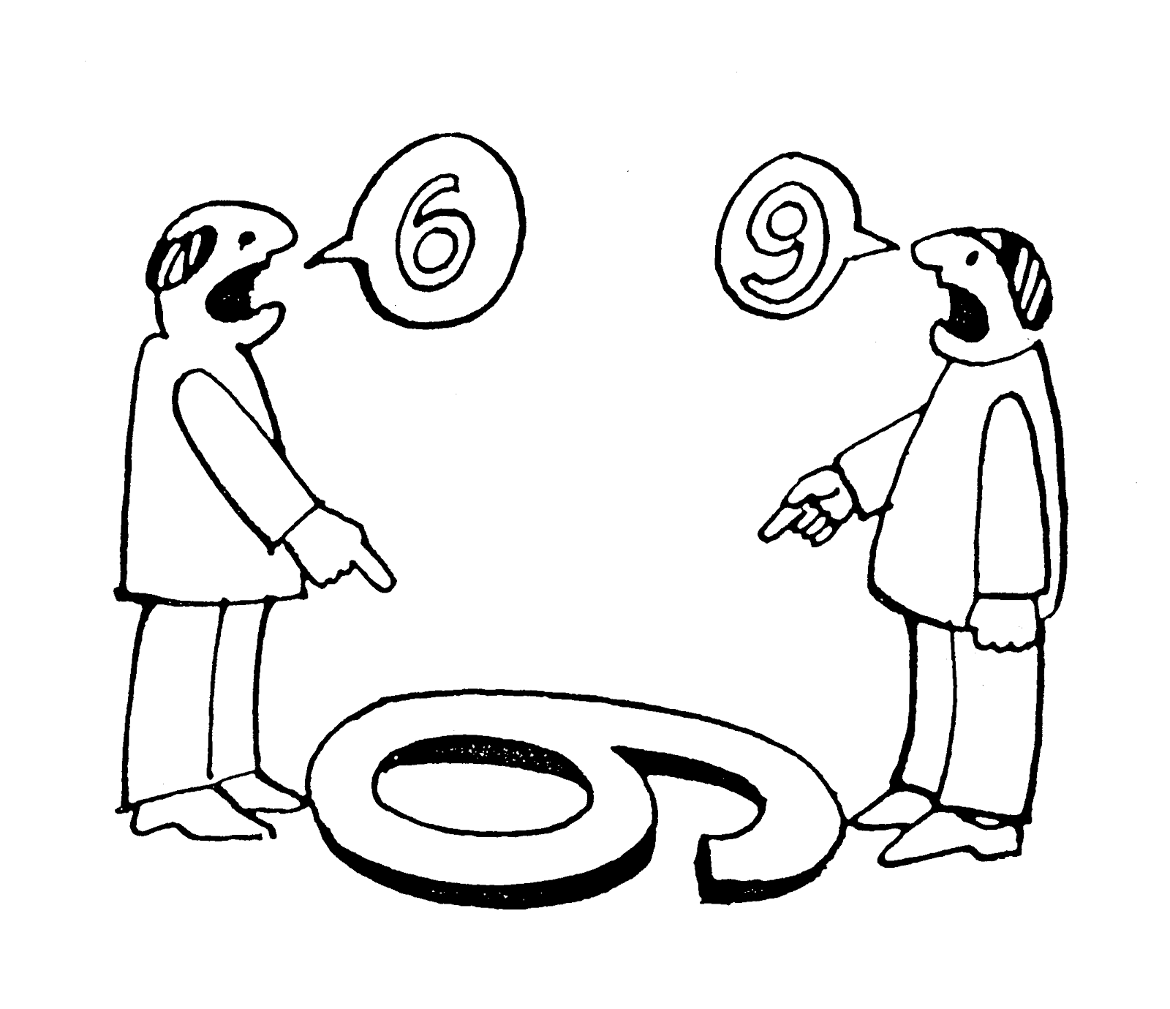
Needs Insights
Media sources that compare opposing views
Way of helping people understand propositions and how to vote on them
Everyone seemed to feel like they were more educated than the average voter
People had their own individual method on how to determine how to vote

Slide 13
Conclusion
Everyone thinks that he/she is more informed than other people
People are getting one-sided news
People struggle to vote in smaller elections and on policies
How informed do people need to be to vote?
Notes:
One of the biggest takeaways is that we don’t have an answer for...

Slide 14
Appendix

Slide 15
What questions we asked
How was the voting experience for you?
How do you decide how to vote on an issue?
How often do you see media that supports/contradicts your own opinion?
Have you ever voted on a referendum? How was that experience different?
What would you want to know about referendums beforehand?
Have you ever taken a quiz about politics that tells you which politicians/ideologies you align with most? Was it accurate/surprising/…?
How do you feel while reading something (political) that you disagree with?
Notes:
Consistent questioning across individuals
Pros: aren’t scattered about with our questions and thus able to discern some kind of pattern
Cons: Maybe asking the same questions also reduces new insights (but that is why we asked follow-up questions)

Slide 16
Interview Contradictions
Do you think people would benefit from reading articles from the other side?
People would become more partisan with contradictory information
People with stronger views would read articles with opposing views and information would go in one ear and out the other
People with more moderate views would benefit from reading articles with opposing views

Slide 17
Notes
Empathy Map
goo.gl/r4Zyju
Interview Notes
goo.gl/2UmnoG
goo.gl/iQShRm
goo.gl/NKEwy1
Notes:
One of the biggest takeaways is that we don’t have an answer for...

